Slide 1
Humanitarian project Health care facility Stolbtsy Central District Hospital
«Active search»

Slide 2
Project summary:
Activity of the «Stolbtsy Central Hospital» is prevention and early detection of breast cancer among the female population of the Stolbtsy district, reducing mortality in this category.
Project purpose:
Breast cancer screening among the female population of the Stolbtsy district.

Slide 3
Project implementation period: From 2024 – to 2026 Year.
Project budget and the amount of funding is:
300 000 $ U.S. dollars
Multiple foreign donations receipts:
Up to one stage of cash flow during the calendar year.

Slide 4
Project
Implementation
Plan
Making a project
Search for commercial offers for medical equipment
Training of medical staff
Installation of medical equipment
Conducting informational and educational work with the population
Early diagnosis of cancer screening among females
Referral of patients with identified pathology for further treatment on National cancer centre of Belarus

Slide 5
Project relevance
number of women aged
50-69
underwent mammogram
17

Slide 6
Project relevance
Mammography is performed in «Nesvizh Central Hospital»
The distance from the city of Stolbtsy to the city of Nesvizh is about 40 kilometres. Poor transport.
There is a flow of patients served by the Nesvizh Central District Hospital (population of 4 districts)
Target group 45 thousand women

Slide 7
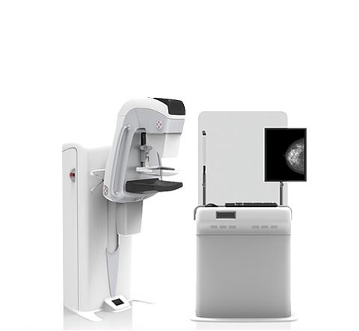
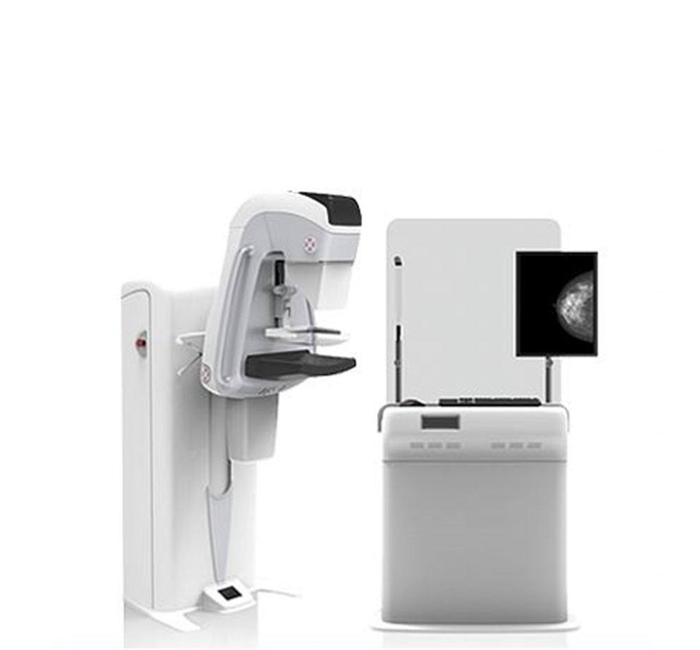
Equipment purchase
Digital Mammogram
ADANI

Slide 8
Currently, 4000 women of the group aged 50-69 years are in need of diagnostic studies using this device.
Performing mammography on the above medical equipment in the "Stolbtsy Central Hospital" eliminates the need for referring women to other healthcare facilities, and increase the availability and speed of mammography.

Slide 9
Expected effects
early detection of breast cancer.
improving the quality and life expectancy of the female population.

