Slide 1
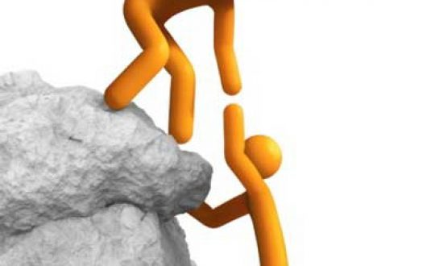
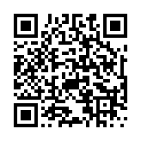
Humanitarian project Health care facility Stolbtsy Central District Hospital
«Foothold»

Slide 2
Project summary:
Activity of the «Stolbtsy Central Hospital» is medical rehabilitation of patients with musculoskeletal diseases and cerebro-vascular diseases.
Project purpose:
rehabilitation of patients after cerebrovascular diseases, diseases of the musculoskeletal system, achievement of the improvement effect in these diseases, reduction of disability.

Slide 3
Project implementation period: From 2024 – to 2026 Year.
Project budget and the amount of funding is:
95 000 $ U.S. dollars.
Multiple foreign donations receipts:
up to three stages of cash flow during the calendar year.

Slide 4
Tasks planned for implementation as part of the project
Purchase of medical equipment for rehabilitation activities for patients with cerebro-vascular diseases and musculoskeletal diseases
Rehabilitation activities after suffering cerebro-vascular diseases, musculoskeletal diseases

Slide 5
PROJECT IMPLEMENTATION PLAN
Preparation project
Conducting a medical equipment procurement procedure
Training of medical personnel.
Equipment installation
Project performance analysis

Slide 6
Project relevance
The Incidence dynamics of cerebrovascular diseases cases of the population of Stolbtsy district for 2021–2023
Year/indicator | ALL | Diagnosed Disability | Of these in working age
2021 | 2366 | 48 | 9
2022 | 2343 | 39 | 9
2023 | 2740 | 48 | 11

Slide 7
Project relevance
The Incidence dynamics of musculoskeletal system cases of the population of the Stolbtsy district for 2021-2023
Year/indicator | ALL | Diagnosed Disability | Of these in working age
2021 | 3102 | 13 | 5
2022 | 3265 | 12 | 4
2023 | 3691 | 15 | 5

Slide 8
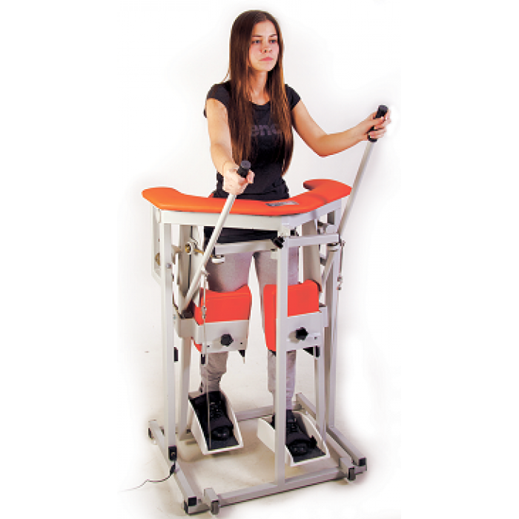
Equipment purchase
Walking simulator "Imitron Walk Simulator" (the cost is 15 000 BYN). It is used to perform a set of rehabilitation exercises in an upright position for the prevention of tendon contractures and joint degeneration after a severe acute cerebrovascular accident, diseases
and injuries of the
musculoskeletal system.
About 1800 patients need
rehabilitation sessions
on this simulator.

Slide 9
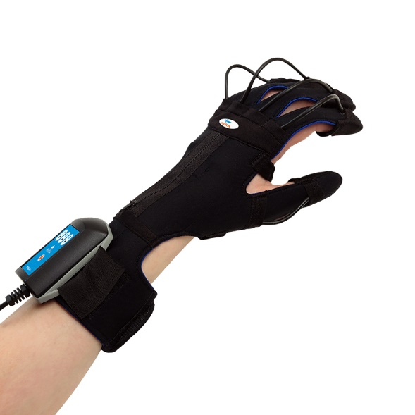
Equipment purchase
Biofeedback simulator "Anika's Rehabilitation Glove" (the cost of the kit is 12 000 BYN). It is used for the rehabilitation
of patients after a stroke,
injuries of the brain and
spinal cord, for the
rehabilitation of the upper
limb after injuries and
operations, with post-traumatic
neuropathies, Parkinson’s
disease, muscular dystrophy
and cerebral palsy.
About 1350 patients need
rehabilitation sessions
on this simulator.

Slide 10
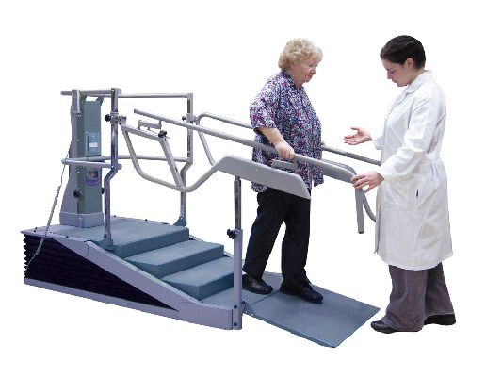
Equipment purchase
Dynamic ladder-bars simulator (Cost – 40 000 BYN)
Designed for early rehabilitation in order to restore walking skills, after suffering brain heart attacks, injuries and other diseases of the nervous system.
About 1000 patients
need rehabilitation
sessions on this
simulator.

Slide 11
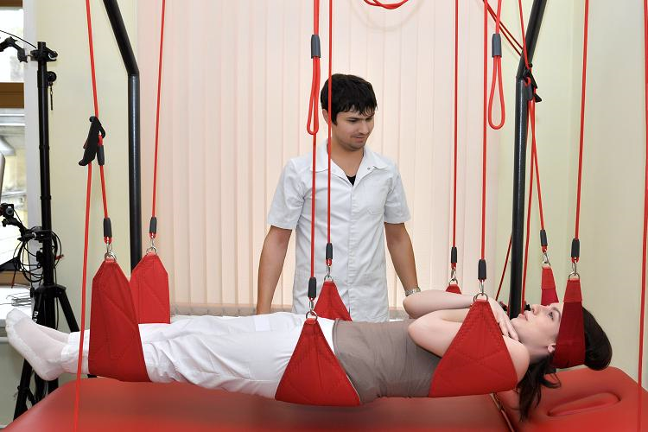
Equipment purchase
Kinesitherapy complex «Exarta»
(cost – 30 000 BYN).
The complex is designed to activate the patient's neuromuscular system, after the cesbre-vascular diseases and diseases of the musculoskeletal system. About 750 patients need rehabilitation sessions on this simulator.

Slide 12
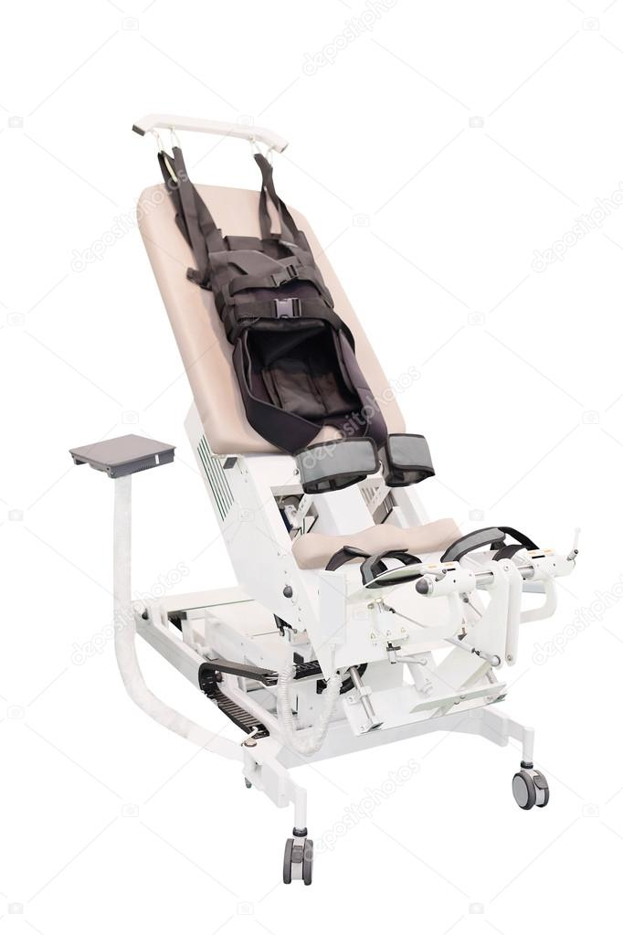
Equipment purchase
Simulator
"verticalizer for rehabilitation" (Cost – 10 000 BYN).
Designed for early physical rehabilitation of patients with motor disorders after suffering acute cerebral circulatory disorders, diseases and injuries of the musculoskeletal system, prevention of secondary complications caused by hypokinesia.
About 650 patients
need rehabilitation
sessions on this
simulator.

Slide 13
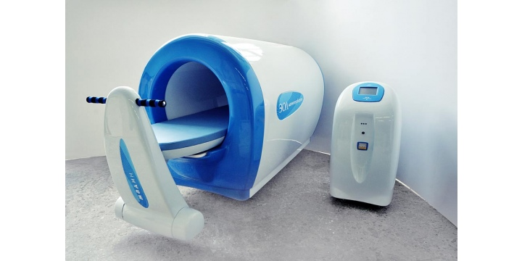
Equipment purchase
Magnetotherapy «Magnetoturbotron Lux»
(the cost is 60 000 BYN). It is designed to rehabilitate patients after suffering injuries, musculoskeletal diseases and nervous system.
About 1900 patients need to carry out rehabilitation activities at this simulator.

Slide 14
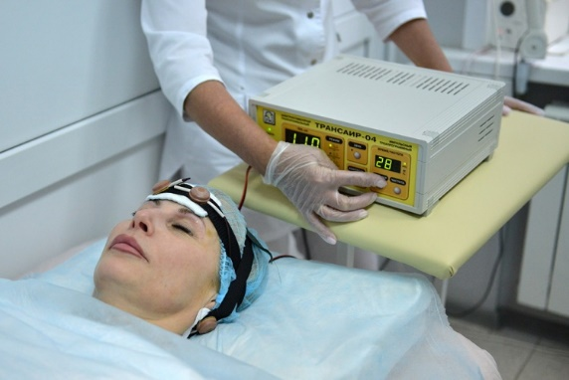
Equipment purchase
Transcranial electrical stimulation device «Transair - 03»
(Cost – 75 000 BYN).
It is designed to rehabilitate patients with diseases of the central nervous system, brain injuries, acute cerebral circulatory disorders.
About 2 100 patients
need rehabilitation
sessions on
this simulator.

Slide 15
Expected effects
Rehabilitation and disability reduction of patients with cerebrovascular, musculoskeletal system diseases, and injuries.
Improving the life quality of patients
increase life expectancy

